Slide 1
An Extendable DASH Streaming System for Dynamic Point Clouds
PRESENTATION
BACHELOR THESIS
Özgür Erol | Supervisor: Michael Rudolph
Networks and Communication Systems | Prof. Dr. –Ing. Amr Rizk
22.09.2022
Notes:
Organizations are increasingly getting more open to the idea of point clouds.
They allow them to create realistic representations of the real world and bring
in the flexibility they need, that sets them apart from other competitors.
Point clouds are not only used in high-tech industries, but are available for the
average consumer: Due to cost-effective and accessible head-mounted displays,
the user is able to engage in immersive virtual reality applications, free from any restrictions.
Although the idea of point clouds sound promising, they are plagued
by what seems to be a reoccurent issue:
And that is their size, resulting in massive memory requirements.
Not only do they create difficulties for storage, but complicate transmission in real time.

Slide 2
AGENDA
01.
Introduction
05.
Implementation
02.
Background
06.
Evaluation
03.
Related Work
07.
Conclusion
04.
Design
Notes:
Before I go any further, allow me to give you a quick overview of my presentation.
After the introduction, I will start with the background section and provide you with
a general understanding of the idea of point clouds.
Next, I present an overview of the current state of point cloud streaming,
including the progress made in point cloud compression.
The second part of this presentation will revolve around the proposed point cloud streaming solution and
focus on design decisions and implementation details.
The evaluation section will present the results of the simulations
that we performed with the proposed system.
Finally, the last section will summarize the main findings of the thesis and present future work.

Slide 3
01 | INTRODUCTION
Video 1 An example for a point cloud

Slide 4
Why Point Clouds?
01 | INTRODUCTION
Rise in popularity due to the accessibility of head-mounted displays ¹
Most favorable format for representing volumetric data ²
Allow the user to change viewport and position
Point Clouds in Practical Use
Immersive virtual and augmented reality (VR/AR) applications ³
Mobile mapping to support autonomous driving ⁴
Problem
Point clouds have immense memory requirements
Research around point cloud streaming is scarce
Contribution
An understanding of the current state of point cloud streaming
A streaming system for point clouds that supports future development
¹ van der Hooft et al., 2019
² Liu et al., 2021
³ Graziosi et al., 2020
⁴ Cui et al., 2019

Slide 5
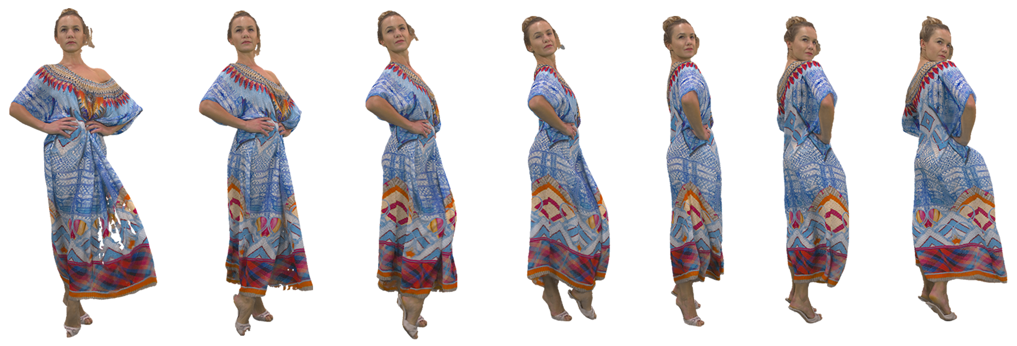
02 | POINT CLOUDS
Definition and Characteristics of Point Clouds
Each point represents a position and other additional attributes (e.g. color) ³
Acquired by photogrammetry and/or depth scanners ^{3,5}
Two types of point clouds: dynamic and static ⁴
Higher point density results in a higher quality
Listing 1 An excerpt of the file content of longdress ⁶
Figure 1 An example for a dynamic point cloud ⁶, containing about 750.000 points per frame
15 211 63 61 133 104 77
16 210 63 63 128 97 69
17 211 62 63 126 97 71
18 211 63 62 130 100 73
19 211 63 63 129 98 71
20 212 63 59 139 110 83
³ Graziosi et al., 2020
⁴ Cui et al., 2019
⁵ Hosseini & Timmerer, 2018
⁶ d’Eon et al., 2017

Slide 6
02 | STREAMING
Idea of Streaming
Two modes of watching a video: download mode and streaming mode ⁷
Streaming mode allows early playback ⁸ and saves storage
Adaptive Bitrate Streaming
Adjusts the video quality to the network conditions of the user ⁵
Requires multiple quality representations
Prevents long starting times and buffering ⁹
Dynamic Adaptive Streaming over HTTP (DASH)
Started with a Call for Proposals (CfP) in 2009 and evolved to an international standard ¹⁰
Uses a Media Presentation Description (MPD)
Requires the client to implement an adaptation algorithm ¹¹
⁵ Hosseini & Timmerer, 2018
⁷ Wu et al., 2001
⁸ Li et al., 2013
⁹ Seufert et al., 2014
¹⁰ Sodagar, 2011
¹¹ Stockhammer, 2011

Slide 7
Point Cloud Compression
03 | COMPRESSION
Compression methods have mainly focused on static point clouds ¹²
Early studies used tree data structures for compression ^{13,14}
MPEG‘s Call for Proposals (2017)
Geometry-based point cloud compression (G-PCC)
Video-based point cloud compression (V-PCC)
Used with static and dynamically acquired point clouds ¹²
Compression using octrees ⁴
Used with dynamic point clouds ⁴
Compression by projecting the data on two-dimensional space ¹⁵
Problem
Compression requires additional software¹⁶
Decoding in real-time is not possible¹
¹ van der Hooft et al., 2019
⁴ Cui et al., 2019
¹² Schwarz et al., 2018
¹³ Huang et al., 2006
¹⁴ Schnabel & Klein, 2006
¹⁵ Liu et al., 2019
¹⁶ Qian et al., 2019

Slide 8
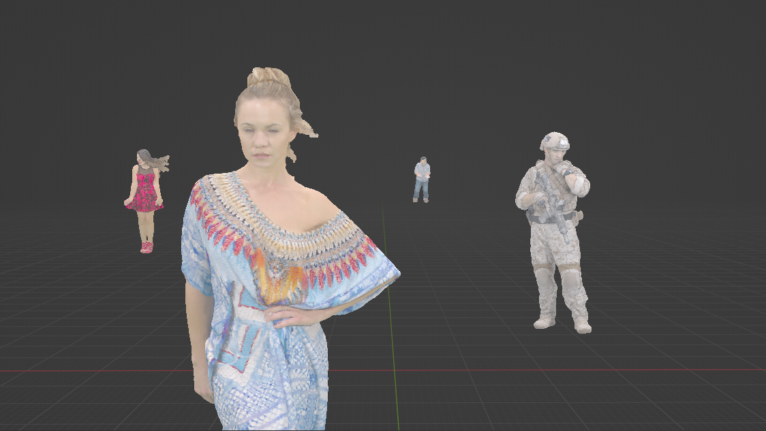
Concept and Results of DASH-PC ⁵
03 | POINT CLOUD STREAMING
Concept and Results of PCC-DASH ¹
Create different quality representations by compressing the point cloud
Rank point cloud objects and assign bandwidth according to importance
Create different quality representations by subsampling the point cloud
Little quality degradation, due to human visual acuity
Adaptation algorithm depends on the scene
Bandwidth savings up to 50-80%
Figure 2 An example for a multi object scene
Video 2 A demonstration of the idea of DASH-PC
¹ van der Hooft et al., 2019
⁵ Hosseini & Timmerer, 2018
Notes:
Sample: 765,000 with 16.4 MB
Subsample: 20,000 with 0.9 MB

Slide 9
04 | THE PROPOSED SYSTEM
Idea of the Proposed System
Make point clouds available to a wide range of consumers
Combine the strengths of existing solutions
Support the development of point cloud streaming
Characteristics of the Point Cloud Streaming System
Adjusts the point cloud quality to the network conditions of the user by implementing DASH
Uses compressed point cloud files, created by V-PCC
Provides the user with the highest quality possible
Supports the creation of new methods
Provides methods for evaluating different point cloud streaming methods
Includes two adaptation algorithms
Configuration of the system
A server to store the point cloud files along with the MPDs
A client that obtains the point clouds and implements an adaptation algorithm

Slide 10
04 | SERVER ARCHITECTURE
Figure 3 The architecture of the server
MPD Creation Module
MPD File
Creates the MPD file
Contains the information for the stream
Configuration File
Compressed Point Cloud Data
Contains the configuration options for the point cloud scene
Are transmitted to the client
Raw Point Cloud Data
Required for analysing the point clouds

Slide 11
04 | CLIENT ARCHITECTURE
Figure 4 The architecture of the client
MPD Parser
Adaptation Algorithm
Reads the MPD file
Throughput Estimator
Estimates the user‘s bandwidth
Configuration File
Contains the configuration options for the client
Bitrate Allocation
Decides how the bandwidth is allocated to the ranked objects
Logging & Diagram Creation
Buffer
Evaluates the performance of the system configuration
Prevents stalls and rebuffering

Slide 12
05 | CONFIGURATION
Listing 2 The configuration file for the client
Listing 3 The configuration file for the server
1 [basic] 2 server_url=192.168.178.73 3 manifest_filename=manifest-multi-10 4 min_buffer_size=2 5 dash_logic=basic 6 # bitrate_allocation=greedy 7 bandwidth_trace=40-wired 8 simulation=true 9 10 [print] # options: ["true"|"false"] 11 print_bandwidth=true 12 print_buffer=true 13 print_file_request=true 14 15 [log] # options: ["true"|"false"] 16 log_bandwidth=false 17 log_buffer=false 18 19 [diagram] # options: ["disable"|"show"|"save"] 20 buffer_chart=save
1 [basic] 2 title=Multi Point Cloud Setting 3 file_format=bin 4 type=dynamic 5 framerate=30 6 duration=1 7 pc_directory_name=point-clouds 8 representation_url=$adaptationset_name$/
$representation_id$/segment_$period_id$ 9 10 [loot] 11 rot=0 0 0 12 pos=-1400 0 0 13
14 [redandblack] 15 rot=0 0 0 16 pos=-900 0 0 17
18 [solder]
19 # ...

Slide 13
05 | MPD
Listing 4 An examplary MPD for point cloud streaming, featuring two point cloud objects
1 <?xml version='1.0' encoding='UTF-8'?> 2 <MPD format="bin" type="dynamic" mediaPresentationDuration="2" framerate="30"> 3 <RepresentationURL>point-clouds/$adaptationset_name$/$representation_id$/segment_$period_id$.bin</RepresentationURL> 4 <Period id="0"> 5 <AdaptationSet id="0" name="longdress" duration="1" pos="100 0 0" rot="0 0 0" size="103 9 22 459 1012 318"> 6 <Representation id="1" bandwidth="4511264" /> 7 <Representation id="2" bandwidth="7704904" /> 8 </AdaptationSet> 9 <AdaptationSet id="1" name="loot" duration="1" pos="-1400 0 0" rot="0 0 0" size="28 7 119 380 999 473"> 10 <Representation id="1" bandwidth="2176080" /> 11 <Representation id="2" bandwidth="3405168" /> 12 </AdaptationSet> 13 </Period> 14 <Period id="1"> 15 <AdaptationSet id="0" name="longdress" duration="1" pos="100 0 0" rot="0 0 0" size="135 6 173 460 992 496"> 16 <Representation id="1" bandwidth="4818680" /> 17 <Representation id="2" bandwidth="8202072" /> 18 </AdaptationSet> 19 <AdaptationSet id="1" name="loot" duration="1" pos="-1400 0 0" rot="0 0 0" size="28 7 134 385 1003 465"> 20 <Representation id="1" bandwidth="2332920" /> 21 <Representation id="2" bandwidth="3564968" /> 22 </AdaptationSet> 23 </Period> 24 </MPD>

Slide 14
05 | SYSTEM
Video 3 Demonstration of the proposed system

Slide 15
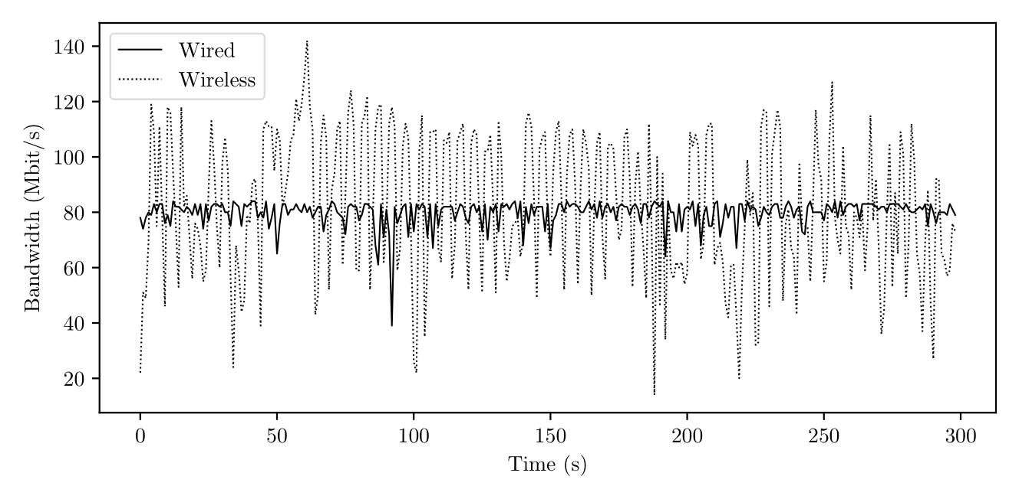
System Configuration
06 | EVALUATION SETUP
2x Raspberry Pi 4 Model B with 4GB of RAM running Ubuntu 22.04 LTS
Server: NGINX HTTP/1.1
Distinction between single object and multi object scenes
Two bandwidth configurations: wired and wireless
Video 4 Positioning of the point cloud objects for the multi object scene ¹
Figure 5 Wired and wireless ¹⁷ bandwidth trace with a mean bandwidth of 80 Mbps
¹ van der Hooft et al., 2019
¹⁷ van Der Hooft et al., 2016

Slide 16
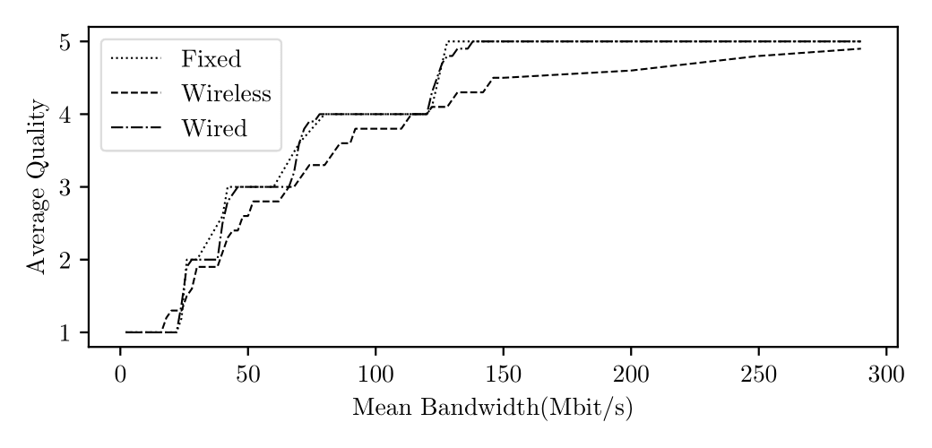
06 | EVALUATION RESULTS
Figure 6 Average quality for (a) a single object scene and (b) a multi object scene with four objects under three different bandwidth configuration using dash basic
(a)
(b)
Results
The wired configuration produces results similar to a fixed bandwidth configuration
The bandwidth fluctuations for a wired/wireless configuration can cause a higher quality
The difference between the wired and wireless graph tends to increase for higher values for the mean bandwidth
A mean bandwidth speed of 60 Mbps for single object scenes and 140 Mps for the multi object scene is required to stream with the highest possible quality

Slide 17
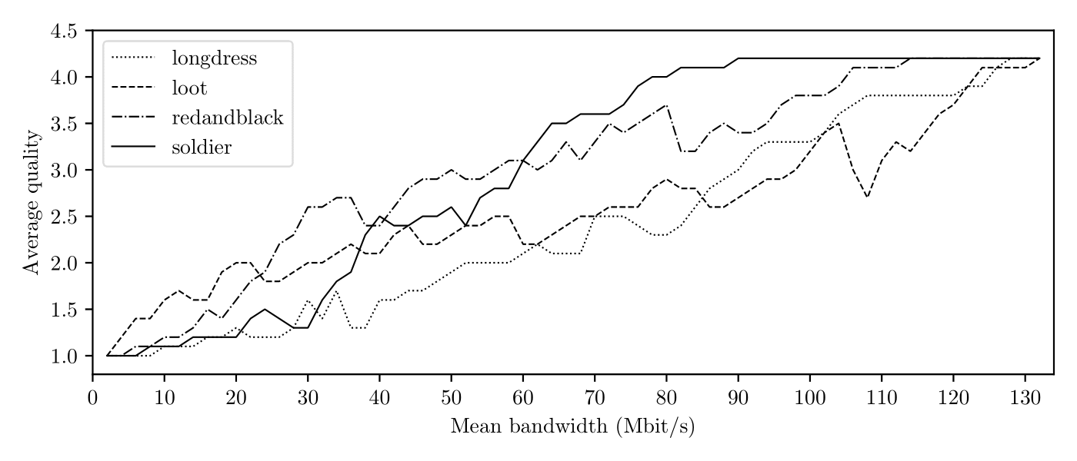
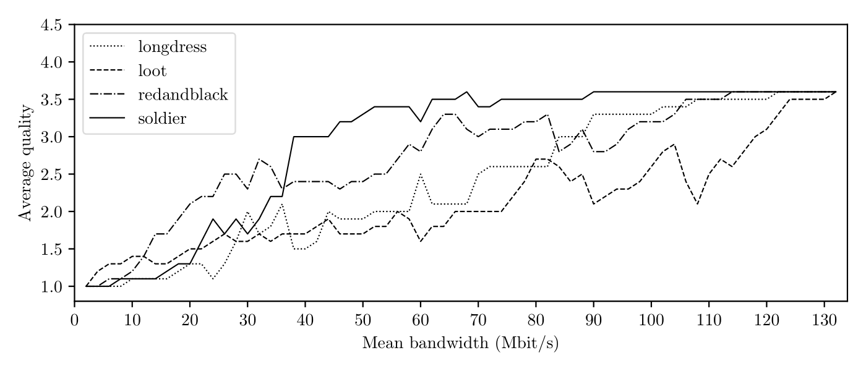
06 | EVALUATION RESULTS
Figure 7 : Distance-based adaptation algorithm, using the (a) greedy bitrate allocation scheme and the (b) uniform
bitrate allocation scheme ¹
(a)
(b)
Results
The loot object has the highest average quality for small values for the mean bandwidth, while the soldier object reaches the maximum quality first
The change in average quality with the greedy bitrate allocation scheme is rather stark
The uniform bitrate allocation scheme produces more balanced results but has a lower overall quality
Balance between quality and performance: Quality switches have a great impact on the user‘s satisfaction, especially is the switches happen abruptly⁹
¹ van der Hooft et al., 2019
⁹ Seufert et al., 2014

Slide 18
Point Cloud Streaming
07 | CONCLUSION
Initial Problem
Point cloud streaming requires high bandwidth speeds
Adaptive bitrate streaming provides support for bandwidth-limited users
Adaptation algorithms are crucial for bandwidth savings
Wireless configurations are prone to quality degradation
The Proposed Point Cloud Streaming System
Evaluates the performance of point cloud streaming methods
Provides a framework for future development
Limitations and Future Work
The throughput estimation module is inaccurate
Decoding requires high processing power, making point cloud streaming impractical
Extend the findings with subjective evaluations

Slide 19
REFERENCES
¹ van der Hooft, Jeroen, et al. "Towards 6dof http adaptive streaming through point cloud compression." Proceedings of the 27th ACM International Conference on Multimedia. 2019.
² Liu, Zhi, et al. "Point cloud video streaming: Challenges and solutions." IEEE Network 35.5 (2021): 202-209.
³ Graziosi, D., et al. "An overview of ongoing point cloud compression standardization activities: Video-based (V-PCC) and geometry-based (G-PCC)." APSIPA Transactions on Signal and Information Processing 9 (2020).
⁴ Cui, Li, et al. "Point-cloud compression: Moving picture experts group's new standard in 2020." IEEE Consumer Electronics Magazine 8.4 (2019): 17-21.
⁵ Hosseini, Mohammad, and Christian Timmerer. "Dynamic adaptive point cloud streaming." Proceedings of the 23rd Packet Video Workshop. 2018.
⁶ d’Eon, Eugene, et al. "8i voxelized full bodies-a voxelized point cloud dataset." ISO/IEC JTC1/SC29 Joint WG11/WG1 (MPEG/JPEG) input document WG11M40059/WG1M74006 7.8 (2017): 11.
⁷ Wu, Dapeng, et al. "Streaming video over the Internet: approaches and directions." IEEE Transactions on circuits and systems for video technology 11.3 (2001): 282-300.
⁸ Li, Baochun, et al. "Two decades of internet video streaming: A retrospective view." ACM transactions on multimedia computing, communications, and applications (TOMM) 9.1s (2013): 1-20.
⁹ Seufert, Michael, et al. "A survey on quality of experience of HTTP adaptive streaming." IEEE Communications Surveys & Tutorials 17.1 (2014): 469-492.
¹⁰ Sodagar, Iraj. "The mpeg-dash standard for multimedia streaming over the internet." IEEE multimedia 18.4 (2011): 62-67.
¹¹ Stockhammer, Thomas. "Dynamic adaptive streaming over HTTP-- standards and design principles." Proceedings of the second annual ACM conference on Multimedia systems. 2011.
¹² Schwarz, Sebastian, et al. "Emerging MPEG standards for point cloud compression." IEEE Journal on Emerging and Selected Topics in Circuits and Systems 9.1 (2018): 133-148.
¹³ Huang, Yan, et al. "Octree-Based Progressive Geometry Coding of Point Clouds." PBG@ SIGGRAPH. 2006.
¹⁴ Schnabel, Ruwen, and Reinhard Klein. "Octree-based Point-Cloud Compression." PBG@ SIGGRAPH 3 (2006).
¹⁵ Liu, Hao, et al. "A comprehensive study and comparison of core technologies for MPEG 3-D point cloud compression." IEEE Transactions on Broadcasting 66.3 (2019): 701-717.
¹⁶ Qian, Feng, et al. "Toward practical volumetric video streaming on commodity smartphones." Proceedings of the 20th International Workshop on Mobile Computing Systems and Applications. 2019.
¹⁷ Van Der Hooft, Jeroen, et al. "HTTP/2-based adaptive streaming of HEVC video over 4G/LTE networks." IEEE Communications Letters 20.11 (2016): 2177-2180.
¹⁸ Subramanyam, Shishir, et al. "User centered adaptive streaming of dynamic point clouds with low complexity tiling." Proceedings of the 28th ACM international conference on multimedia. 2020.
¹⁹ "JPEG Pleno Database: GTI-UPM Point-cloud data set", http://plenodb.jpeg.org/pc/upm. Accessed 21 September 2022
²⁰ “GeoSLAM Point Cloud Animation | Road Data” YouTube, uploaded by GeoSLAM, 2021, www.youtube.com/watch?v=2Zpw_KAEhDY.

Slide 20
Appendix

Slide 21
HTTP
Benefits of Hypertext Transfer Protocol (HTTP) over Real-time Transport Protocol (RTP) ¹⁰
The internet infrastructure along with content delivery networks (CDNs) supports HTTP
HTTP requests can pass through any firewall
The server does not store session states
Which applications use HTTP for Streaming? ⁹
Apple‘s HTTP Live Streaming (HAS)
Adobe‘s HTTP Dynamic Streaming (HDS)
Dynamic Adaptive Streaming over HTTP (DASH)
⁹ Seufert et al., 2014
¹⁰ Sodagar, 2011
Notes:
Client-server protocol, therefore, the requests can pass through firewalls

Slide 22
V-PCC COMPRESSION
Idea of Video-based point cloud compression (V-PCC) ^{12,15}
Patch Generation: By estimating the normal for each point, 3D patches are generated and projected onto a plane
Patch Packing: The patches are placed on a 2D grid, while minimizing the space
Occupance Map Generation: A binary map to examine wether a block of the 2D grid is occupied
Image Generation: The geometry and texture information is stored in 2D images
Padding: Creates a smooth transition between patches, which is beneficial for video encoding
Video Encoding: The geometry and texture images, along with the occupancy map is compressed using traditional video encoders.
¹² Schwarz et al., 2018
¹⁵ Liu et al., 2019

Slide 23
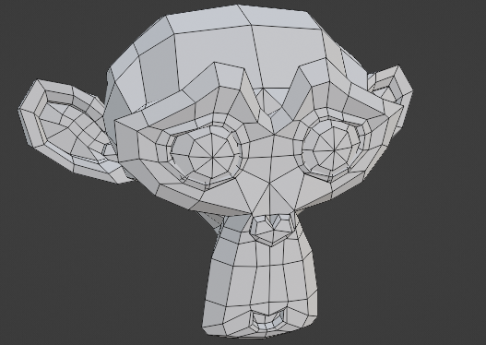
Drawbacks of 3D Meshes ¹⁵
VOLUMETRIC DATA FORMATS
Figure 8 Example of a 3D mesh
Natural objects are difficult to reconstruct with 3D meshes
High data volume
High rendering complexity
Compression methods concentrate on computer generated objects
Why choose Point Clouds? ¹⁸
Easy to acquire
Low rendering complexity
¹⁵ Liu et al., 2019
¹⁸ Subramanyam et al., 2020

Slide 24
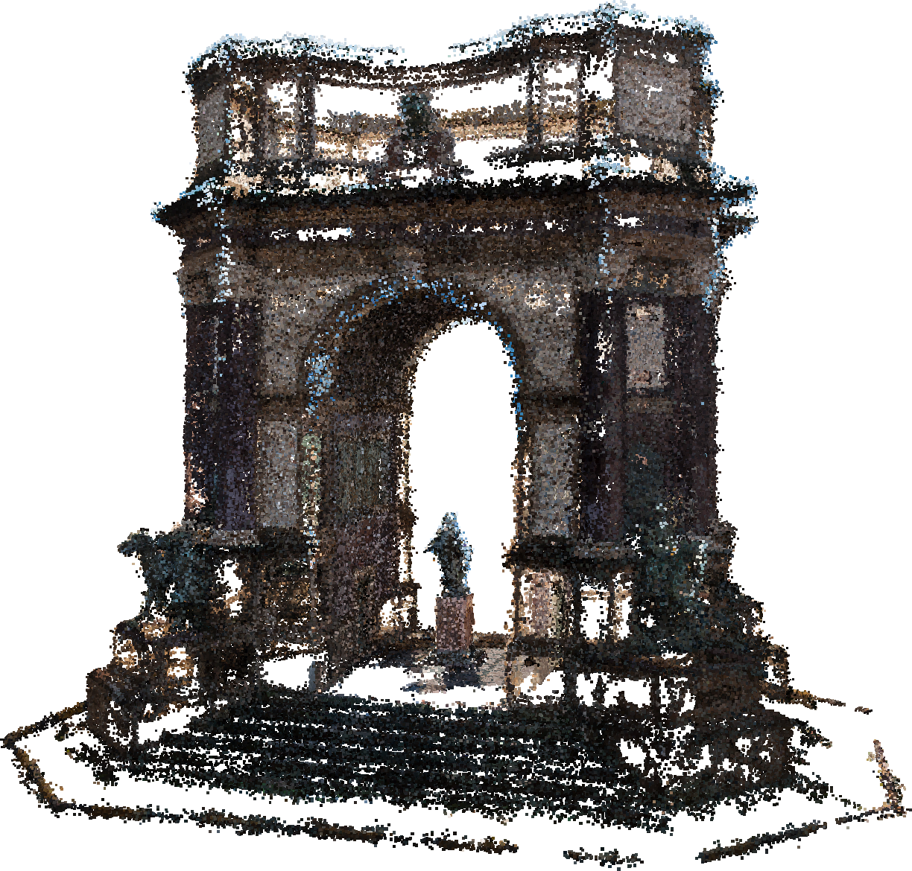
Types of Point Clouds
POINT CLOUDS
Figure 9 Static ¹⁹
Video 5 Dynamic ⁶
Figure 11 Dynamically Acquired ²⁰
⁶ d’Eon et al., 2017
¹⁹ JPEG Pleno Database: GTI-UPM Point-cloud data set
²⁰ GeoSLAM Point Cloud Animation, 2021

